Slide 1
Unit-IV: Association Analysis
Introduction
Apriori Algorithm
FP Growth Algorithm

Slide 2
Introduction
Association Rule Mining:
“Given a set of transactions, find rules that will predict the occurrence of an item based on the occurrences of other items in the transaction”

Slide 3
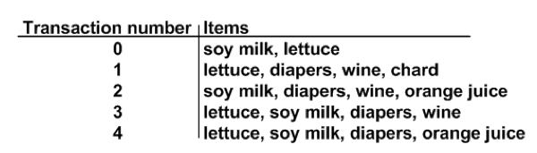
Introduction

Slide 4
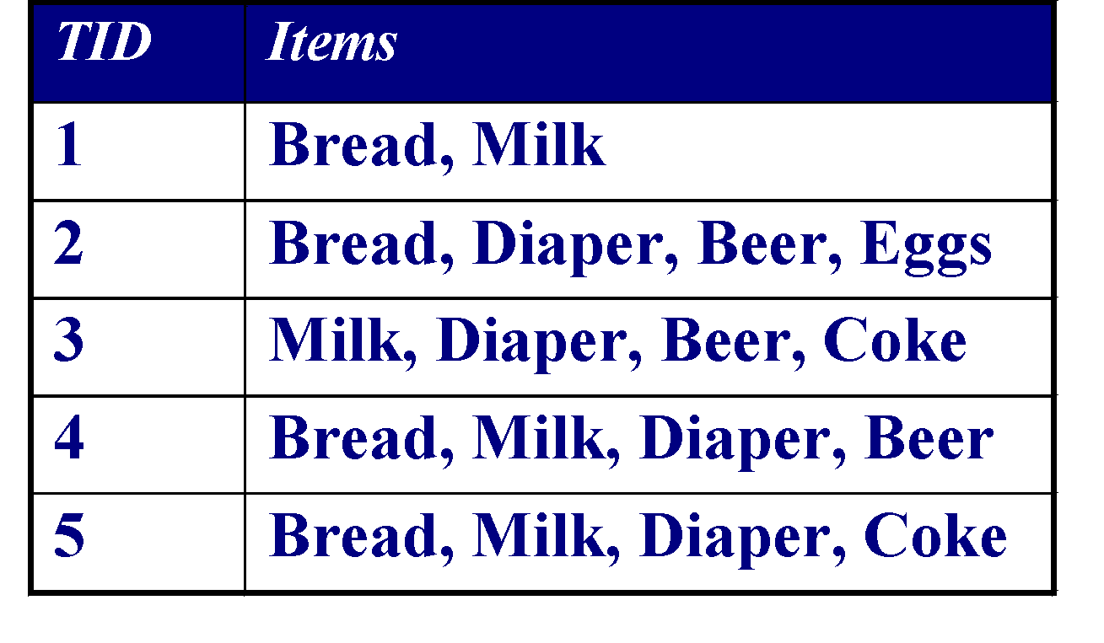
Association Rule Mining
Market-Basket transactions
Example of Association Rules
{Diaper} → {Beer}, {Milk, Bread} → {Eggs,Coke}, {Beer, Bread} → {Milk},
Implication means co-occurrence….

Slide 5
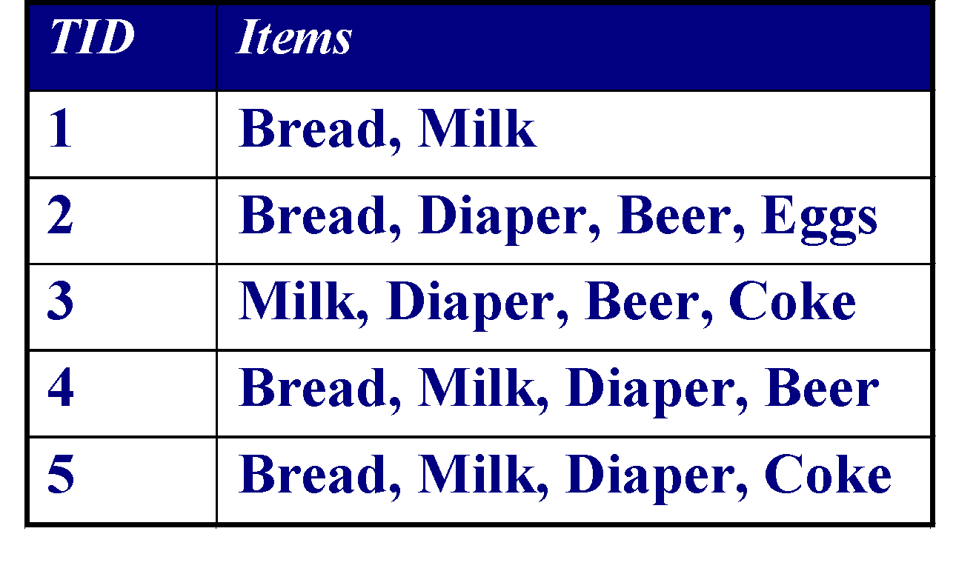
Definition: Frequent Itemset
Itemset
A collection of one or more items
Example: {Milk, Bread, Diaper}
k-itemset
An itemset that contains k items
Support count (σ)
Frequency of occurrence of an itemset
E.g. σ({Milk, Bread,Diaper}) = 2
Support
Fraction of transactions that contain an itemset
E.g. s({Milk, Bread, Diaper}) = 2/5
Frequent Itemset
An itemset whose support is greater than or equal to a minsup threshold

Slide 6

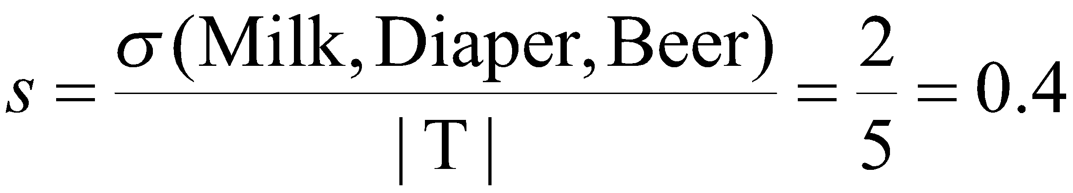
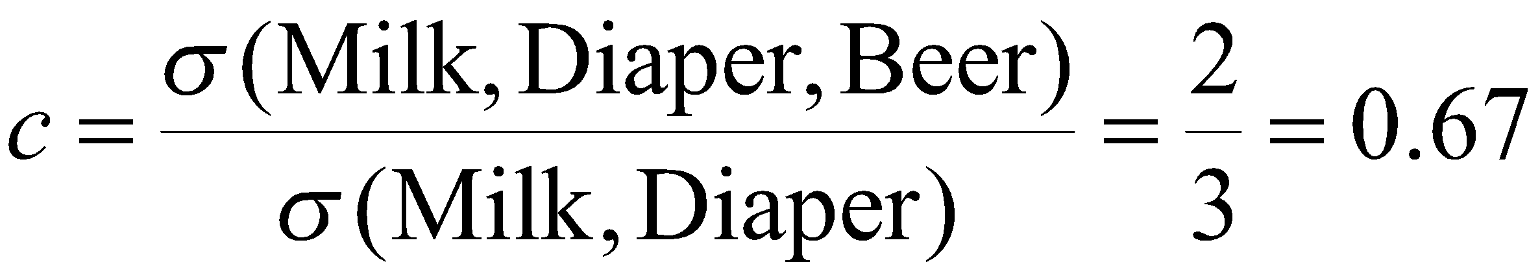
Association Rule
Association Rule
An implication expression of the form X → Y, where X and Y are itemsets
Example: {Milk, Diaper} → {Beer}
Rule Evaluation Metrics
Support (s)
Fraction of transactions that contain both X and Y
Confidence (c)
Measures how often items in Y appear in transactions that contain X
Example:

Slide 7
Association Rule Mining Task
Given a set of transactions T, the goal of association rule mining is to find all rules having
support ≥ minsup threshold
confidence ≥ minconf threshold
Brute-force approach:
List all possible association rules
Compute the support and confidence for each rule
Prune rules that fail the minsup and minconf thresholds
⇒ Computationally prohibitive!

Slide 8
Apriori Algorithm
Apriori is designed to operate on databases containing transactions.
The algorithm attempts to find subsets which are common or frequent.
Apriori uses a "bottom up" approach, where frequent subsets are extended one item at a time (a step known as candidate generation, and groups of candidates are tested against the data)
The algorithm terminates when no further successful extensions are found.

Slide 9
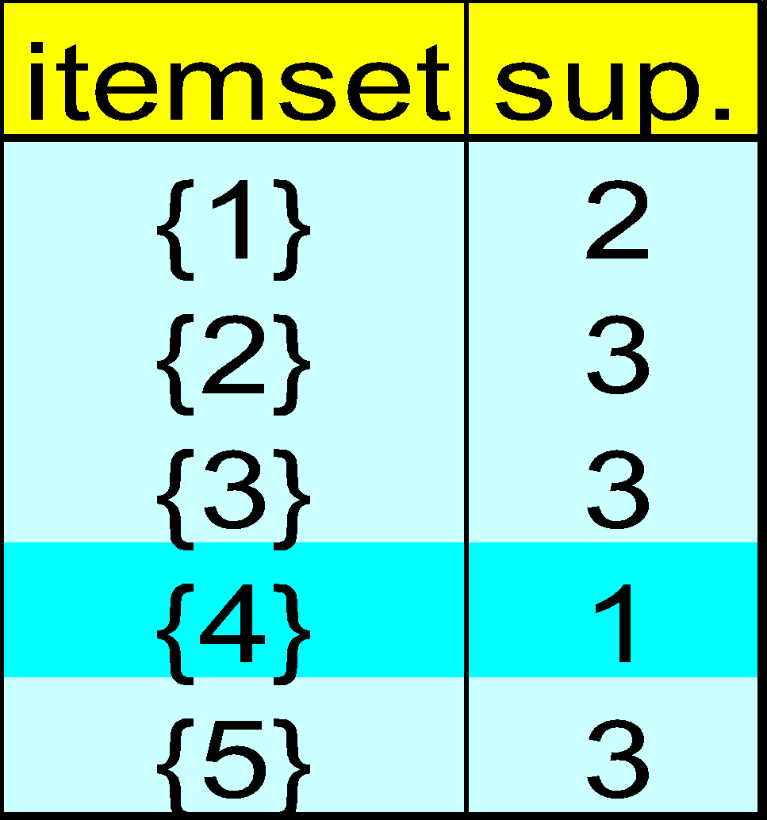
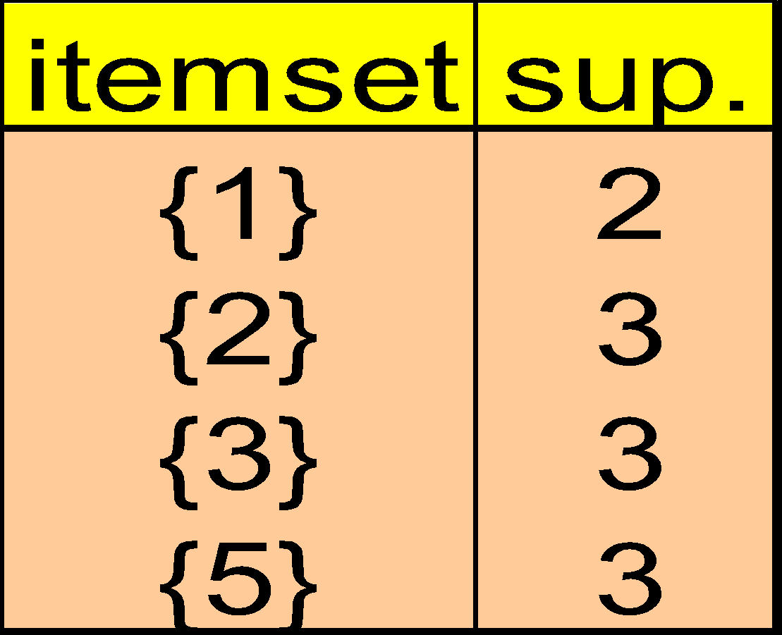
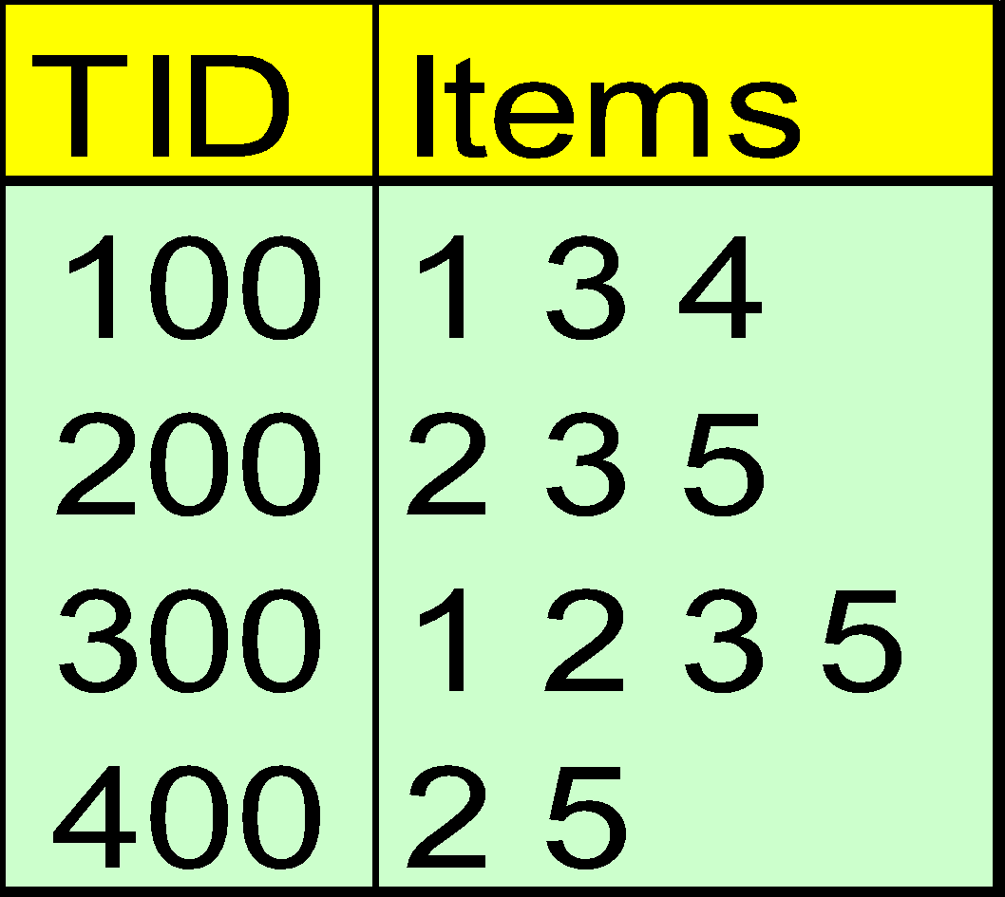
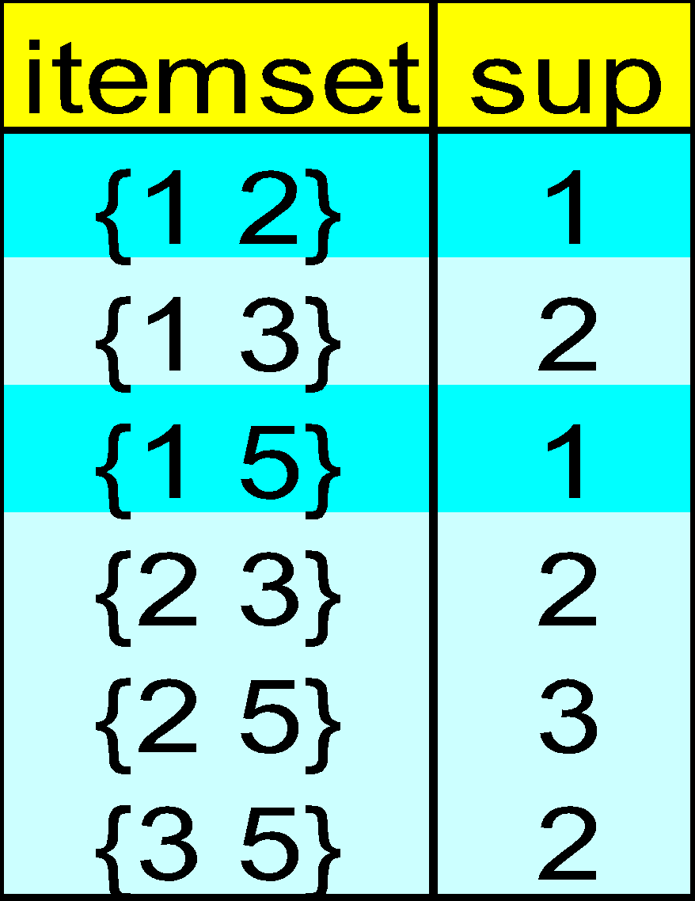
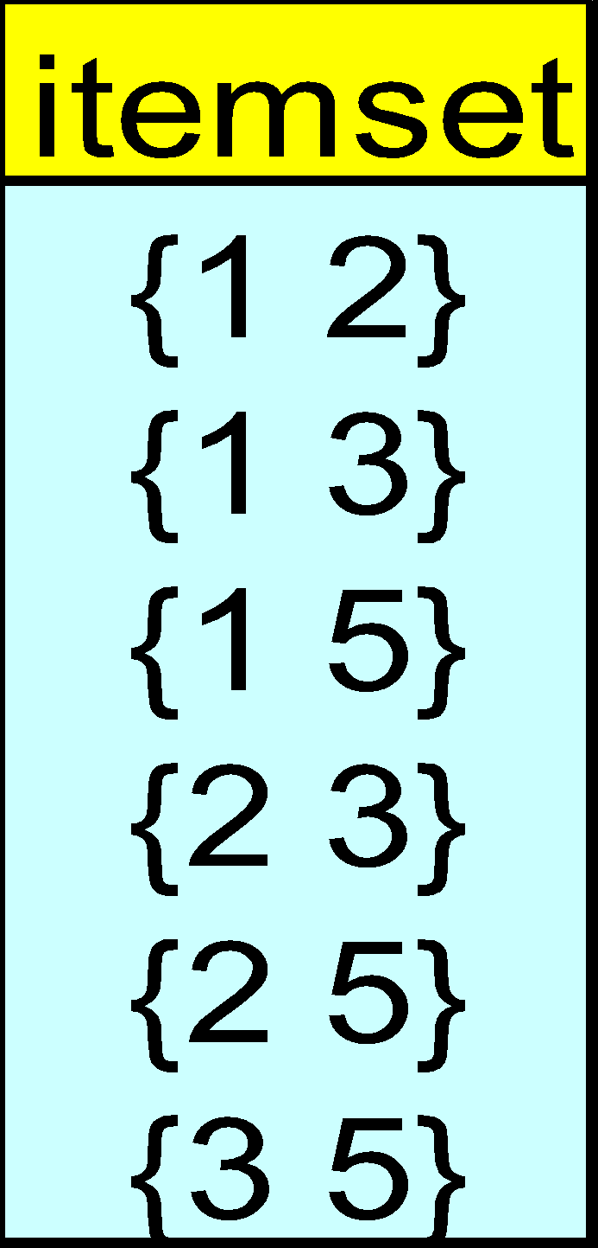
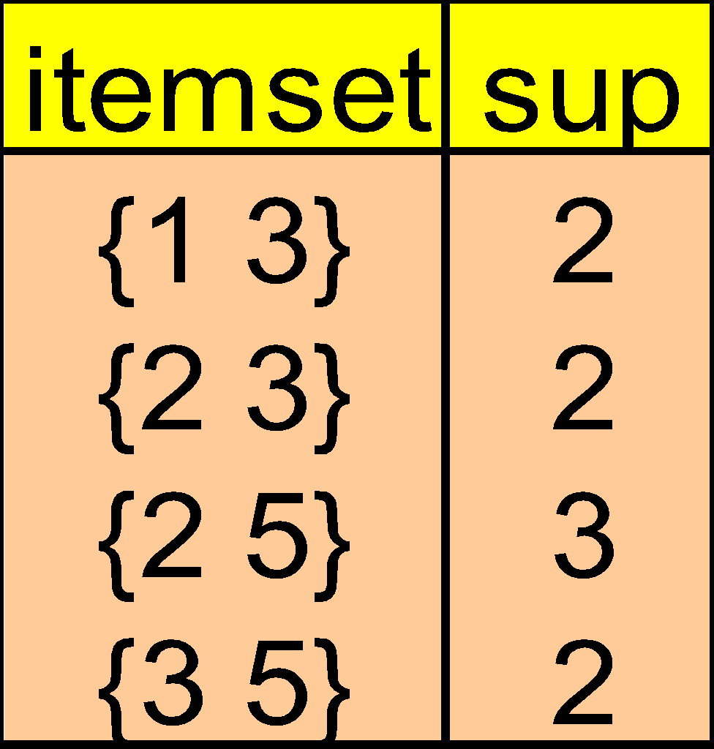
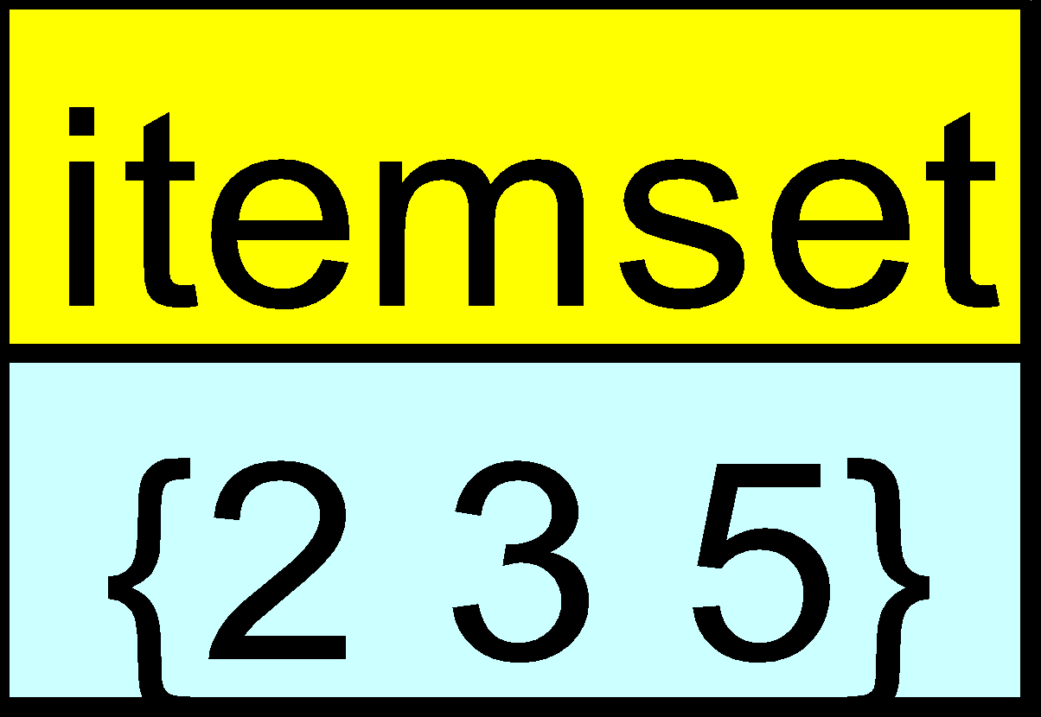
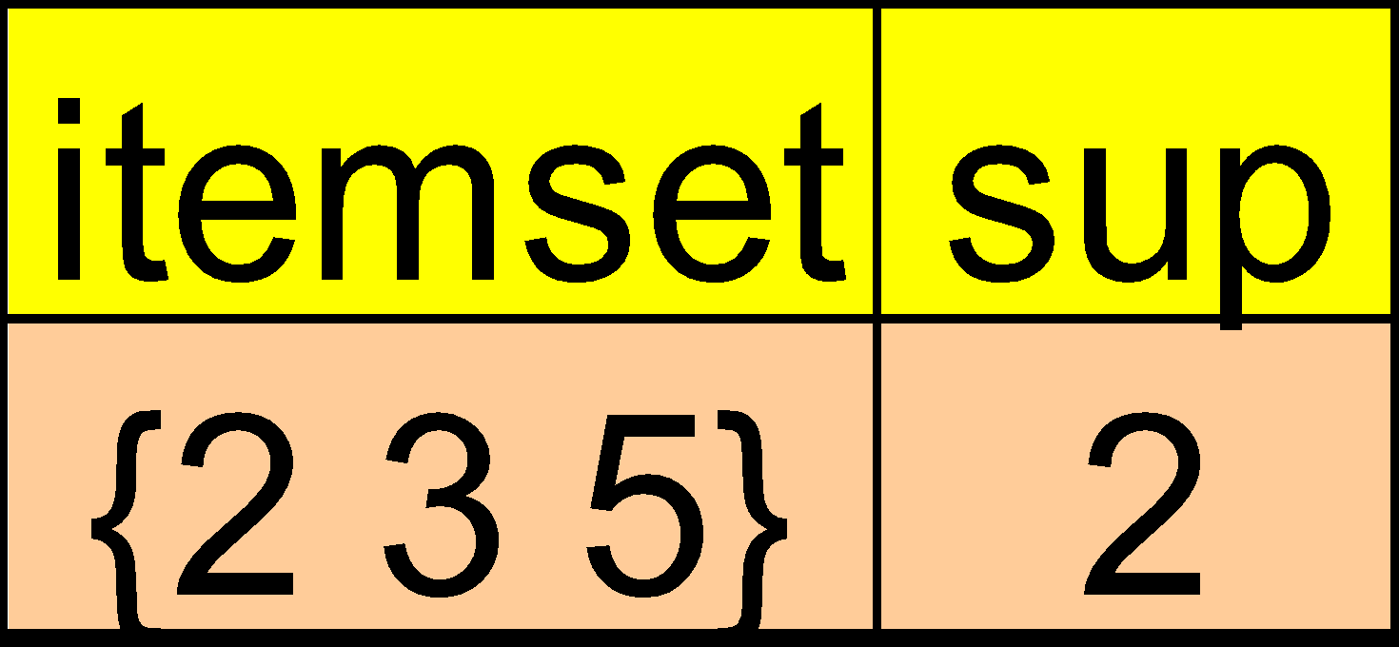
The Apriori Algorithm — Example
Min support =50%
Database D
L₁
C₁
Scan D
C₂
C₂
L₂
Scan D
C₃
Scan D
L₃

Slide 10
The Apriori Algorithm
Join Step: C_{k} is generated by joining L_{k-1}with itself
Prune Step: Any (k-1)-itemset that is not frequent cannot be a subset of a frequent k-itemset
Pseudo-code:
C_{k}: Candidate itemset of size k
L_{k} : frequent itemset of size k
L₁ = {frequent items};
for (k = 1; L_{k} !=∅; k++) do begin
C_{k+1} = candidates generated from L_{k};
for each transaction t in database do
increment the count of all candidates in C_{k+1} that are contained in t
L_{k+1} = candidates in C_{k+1} with min_support
end
return ∪_{k} L_{k};

Slide 11
TID | List of Item_IDs
T100 | I1, I2, I5
T200 | I2, I4
T300 | I2, I3
T400 | I1, I2, I4
T500 | I1, I3
T600 | I2, I3
T700 | I1, I3
T800 | I1, I2, I3, I5
T900 | I1, I2, I3

Slide 12
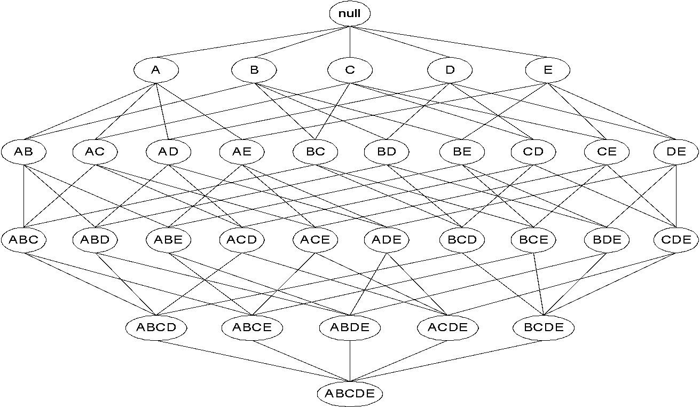
Apriori Principle
If an itemset is frequent, then all of its subsets must also be frequent
If an itemset is infrequent, then all of its supersets must be infrequent too
frequent
frequent
infrequent
infrequent

Slide 13
Performance Bottlenecks of Apriori
Bottlenecks of Apriori: candidate generation
Generate huge candidate sets:
10⁴ frequent 1-itemset will generate 10⁷ candidate 2-itemsets
To discover a frequent pattern of size 100, e.g., {a₁, a₂, …, a₁₀₀}, one needs to generate 2¹⁰⁰ ≈ 10³⁰ candidates.
Candidate Test incur multiple scans of database.

Slide 14
FP (Frequency Pattern) Growth Algorithm
I t allows frequent itemset discovery without candidate generation.
FP Growth follows a two step procedure:
1.Build a compact data structure called the FP-tree
Two passes over the database
2.Extracts frequent itemsets directly from the FP-tree
Traverse through FP-tree

Slide 15
FP-tree
FP-tree Example: step 1
Step 1: Scan DB for the first time to generate L and MinSup=3
L
TID Items bought
100 {f, a, c, d, g, i, m, p}
200 {a, b, c, f, l, m, o}
300 {b, f, h, j, o}
400 {b, c, k, s, p}
500 {a, f, c, e, l, p, m, n}
Item frequency
f 4
c 4
a 3
b 3
m 3
p 3
By-Product of First Scan of Database
Mining Frequent Patterns without Candidate Generation (SIGMOD2000)

Slide 16
FP-tree
FP-tree Example: step 2
Step 2: scan the DB for the second time, order frequent items in each transaction
TID Items bought (ordered) frequent items
100 {f, a, c, d, g, i, m, p} {f, c, a, m, p}
200 {a, b, c, f, l, m, o} {f, c, a, b, m}
300 {b, f, h, j, o} {f, b}
400 {b, c, k, s, p} {c, b, p}
500 {a, f, c, e, l, p, m, n} {f, c, a, m, p}
Mining Frequent Patterns without Candidate Generation (SIGMOD2000)

Slide 17
FP-tree
FP-tree Example: step 2
Step 2: construct FP-tree
{}
{}
f:1
f:2
{f, c, a, m, p}
{f, c, a, b, m}
{}
c:1
c:2
a:1
a:2
m:1
m:1
b:1
NOTE: Each transaction corresponds to one path in the FP-tree
p:1
p:1
m:1
Mining Frequent Patterns without Candidate Generation (SIGMOD2000)

Slide 18
FP-tree
FP-tree Example: step 2
Step 2: construct FP-tree
{}
{}
{}
f:3
f:3
c:1
f:4
c:1
{f, b}
{c, b, p}
{f, c, a, m, p}
c:2
b:1
c:2
b:1
b:1
c:3
b:1
b:1
a:2
a:2
p:1
a:3
p:1
m:1
b:1
m:1
b:1
m:2
b:1
p:1
m:1
p:1
m:1
p:2
m:1
Node-Link
Mining Frequent Patterns without Candidate Generation (SIGMOD2000)

Slide 19
Final FP-tree:
{}
Header Table
Item frequency head
f 4
c 4
a 3
b 3
m 3
p 3
f:4
c:1
c:3
b:1
b:1
a:3
p:1
m:2
b:1
p:2
m:1

Slide 20
Find Patterns conditional Database
Starting at the frequent item header table in the FP-tree
Traverse the FP-tree by following the link of each frequent item p
Accumulate all of transformed prefix paths of item p to form p’s conditional pattern base
{}
Header Table
Item frequency head
f 4
c 4
a 3
b 3
m 3
p 3
f:4
c:1
Conditional pattern bases
item cond. pattern base
c f:3
a fc:3
b fca:1, f:1, c:1
m fca:2, fcab:1
p fcam:2, cb:1
c:3
b:1
b:1
a:3
p:1
m:2
b:1
p:2
m:1

Slide 21
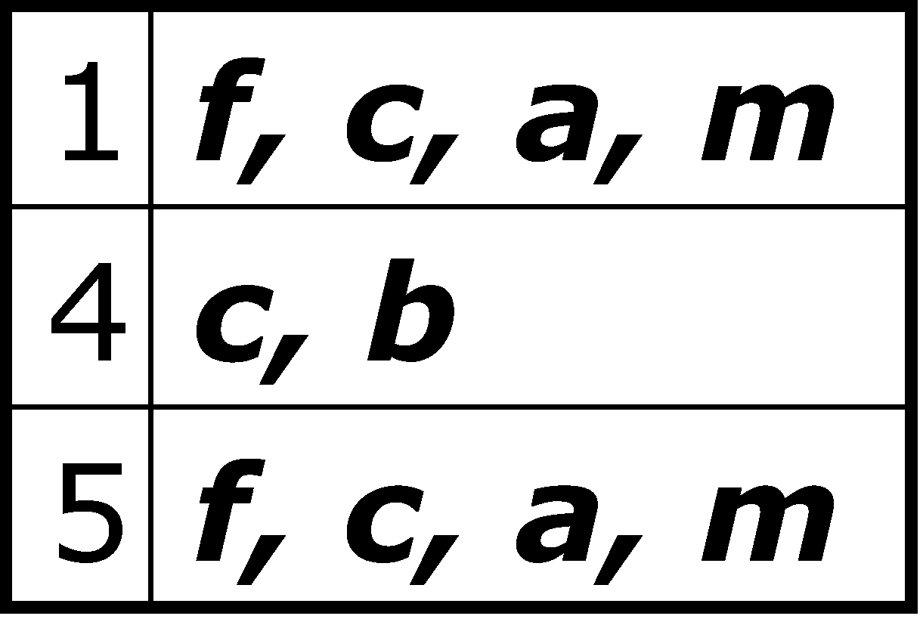
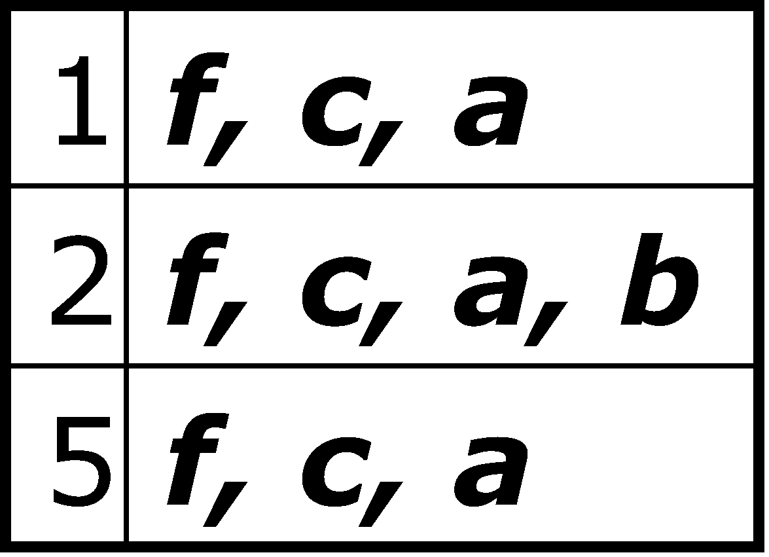
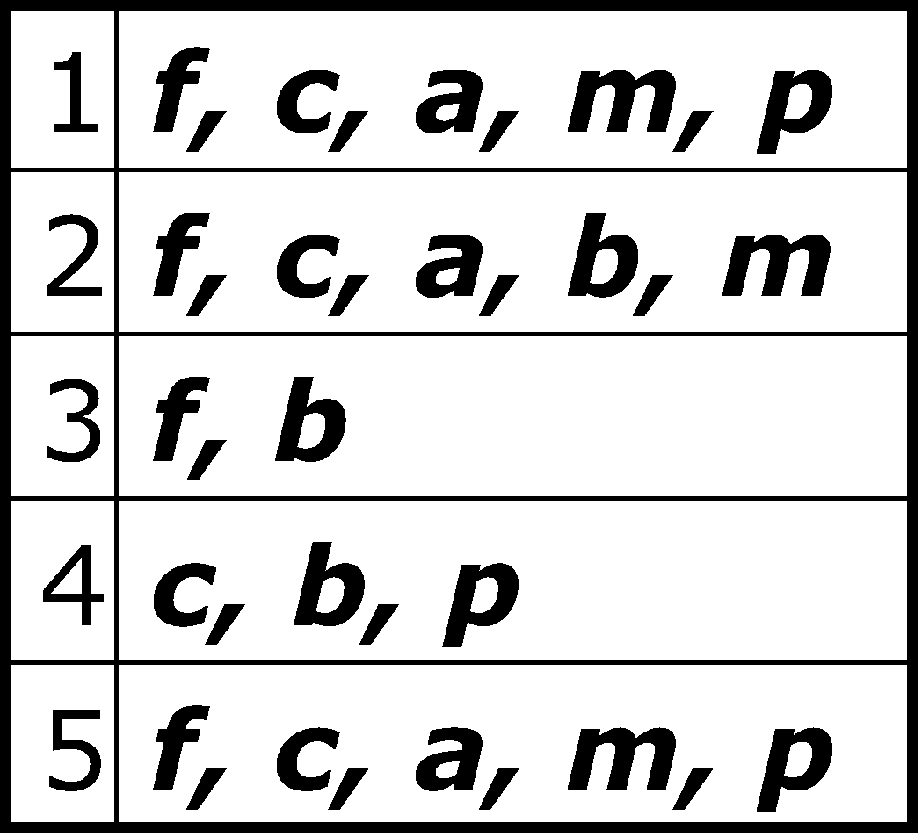
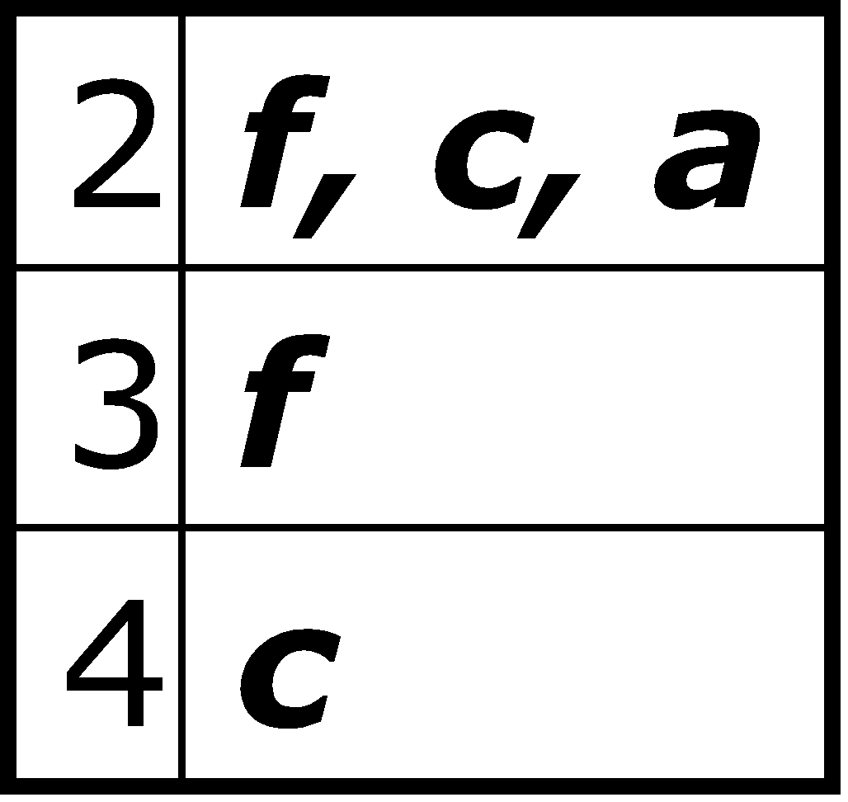
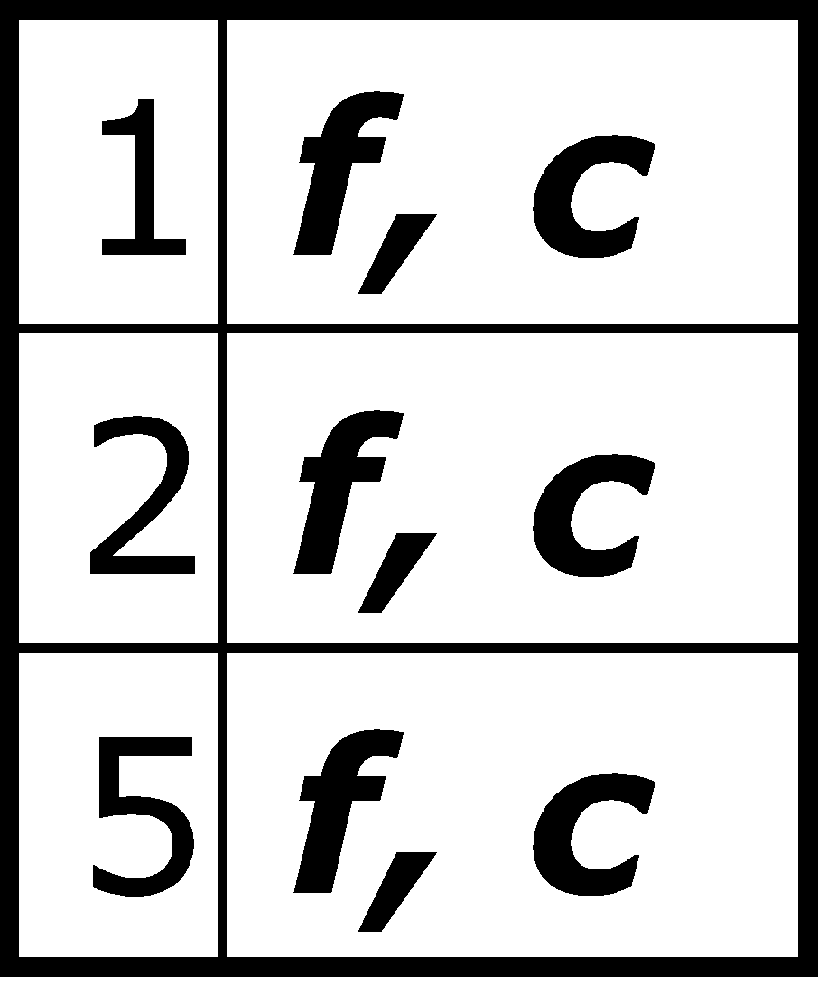
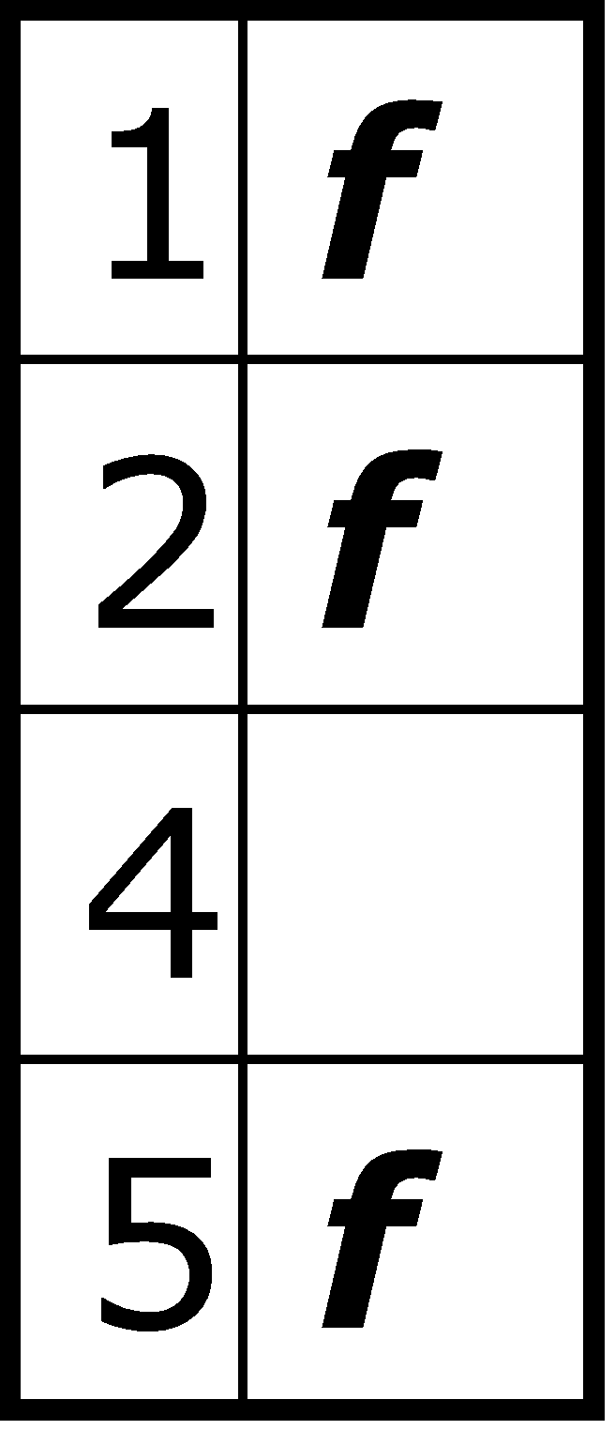
FP-Growth
+ p
+ m
(1)
(2)
+ b
+ a
(3)
(4)
+ c
f: 1,2,3,5
(6)
(5)

Slide 22
{}
{}
f:2
c:1
f:3
c:2
b:1
c:3
{}
a:2
p:1
a:3
f:4
c:1
+ p
b:1
+ m
m:2
c:3
b:1
b:1
(1)
(2)
a:3
p:1
{}
{}
{}
m:2
b:1
f:2
c:1
f:3
f:4
f:3
p:2
m:1
c:1
c:3
+ c
+ a
+ b
a:1
(3)
(4)
(5)
(6)

Slide 23
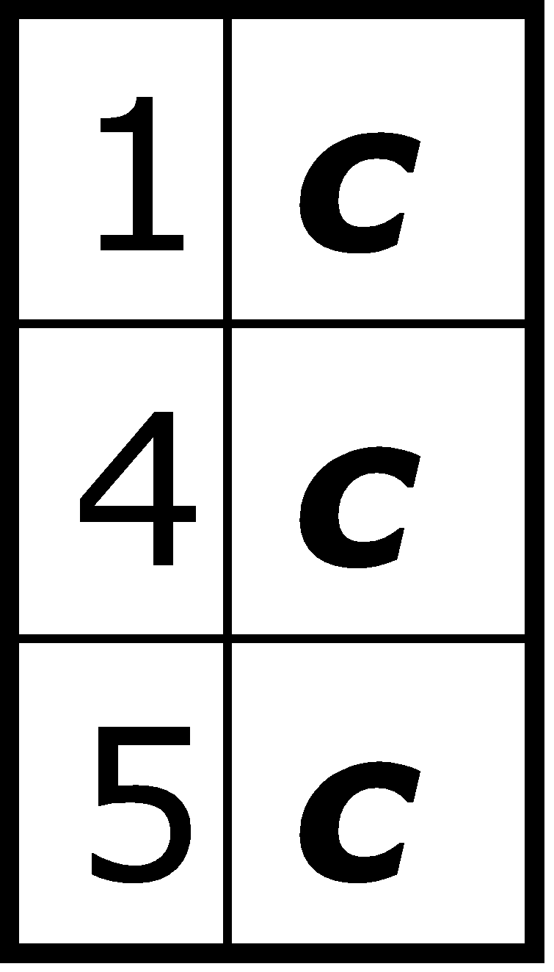
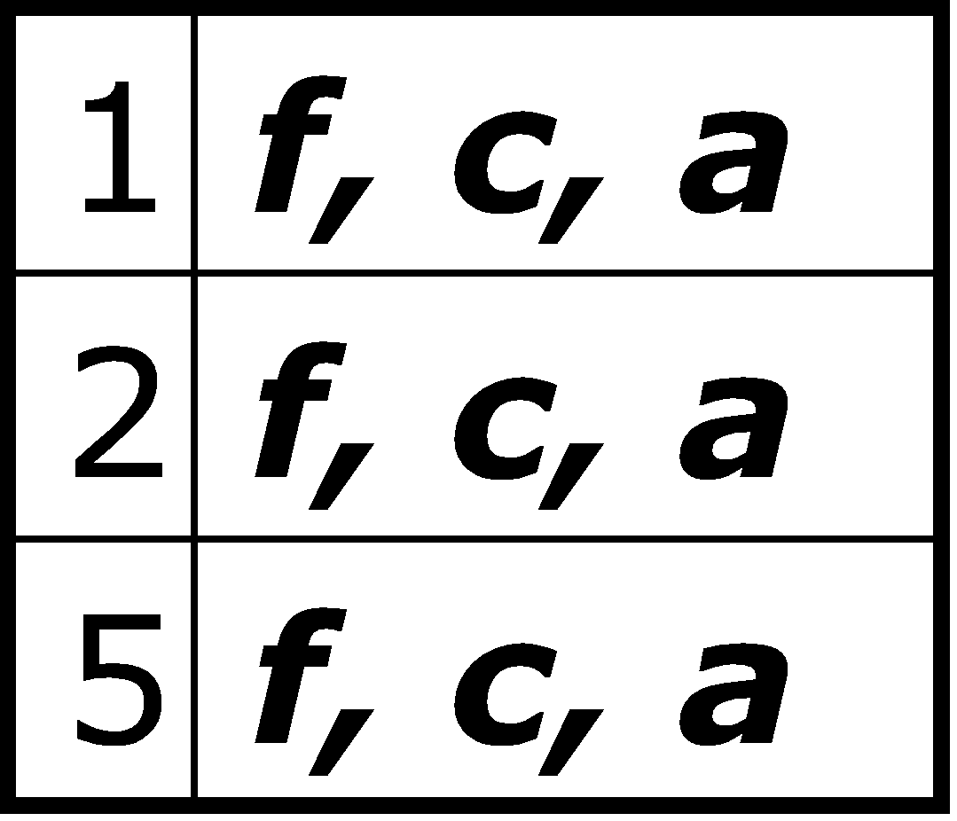
+ p
p: 3 cp: 3
+ p
+ m
m: 3 fm: 3 cm: 3 am: 3 fcm: 3 fam: 3 cam: 3 fcam: 3
min_sup = 3
+ m
+ b
b: 3
a: 3 fa: 3 ca: 3 fca: 3
+ a
c: 4 fc: 3
+ c
f: 1,2,3,5
f: 4

Slide 24
FP-Growth Algorithm:
The FP-Growth Approach
Depth-first search (Apriori: Breadth-first search)
Avoid explicit candidate generation
FP-Growth approach:
For each frequent item, construct its conditional pattern-base, and then its conditional FP-tree
Repeat the process on each newly created conditional FP-tree
Until the resulting FP-tree is empty, or it contains only one path—single path will generate all the combinations of its sub-paths, each of which is a frequent pattern
Fp-tree construatioin:
Scan DB once, find frequent 1-itemset (single item pattern)
Sort frequent items in frequency descending order, f-list
Scan DB again, construct FP-tree

